Slide 1
IAR and Indiana’s Housing Market
August 18, 2023

Slide 2
The Indiana Association of REALTORS® advocates on behalf of the real estate industry, advances ethical standards and sustainable success for its members and promotes thriving communities for a stronger Indiana.

Slide 6
IAR Strategic Priorities: 2022-2025
Earn member loyalty by elevating – and conveying – IAR’s value to members
Deepen relationships with Managing Brokers
Communicate advocacy success & engage REALTORS® in promoting pro-homeowner policies
Proactively raise the bar for preparation, accountability and professional standards
Differentiate and aggressively communicate the REALTOR® brand value

Slide 7
IAR’s Value to Members: Building from the Basics
NAR ➤ IAR ➤ Local Association
What services are most impactful, best delivered at the state level?
Legal: Risk reduction, transactional efficiency (140+ legal forms), expert resources aligned with Indiana law, REALTOR® standards of practice
Education & Professional Standards: Member benefit CE (RECP)
Advocacy/Government Relations: Advancing pro-homeowner policies, protecting taxpayers and the REALTOR® bottom line
Data: Collection and management of MLS market data
Communications: Statewide marketing, public relations (leveraging data) – watch your inbox!

Slide 8
Indiana’s housing market – what we’re seeing in 2023

Slide 9
Is Indiana’s housing recession over?

Slide 10
Home sales rebounded faster than new listings early in ‘23
Statewide sales grew 60% from January through March
New listings lagged behind, strong demand took a toll on total inventory
Limited supply and elevated rates caused homebuyers to pull back – July sales finished 19% below 2022

Slide 11
Why have sellers been slower to return to the market?
99% of outstanding mortgages have interest rates below 6.5%
70% of outstanding mortgages have rates below 4%
Potential sellers face the prospect of finding and financing a new home at rates near 7% and are staying put instead
The impact of higher rates on homebuyers is obvious – but the ‘lock in’ effect of pre-2022 home loans is adding to inventory pressures

Slide 12
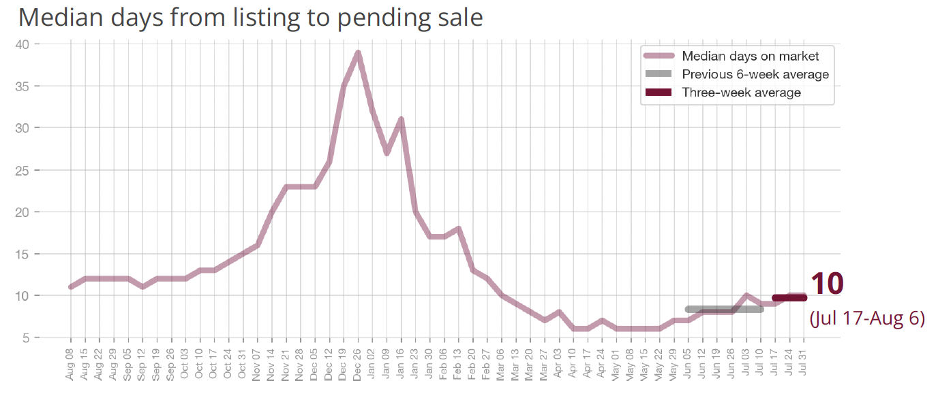
The market is slowing down (earlier than usual)

Slide 13
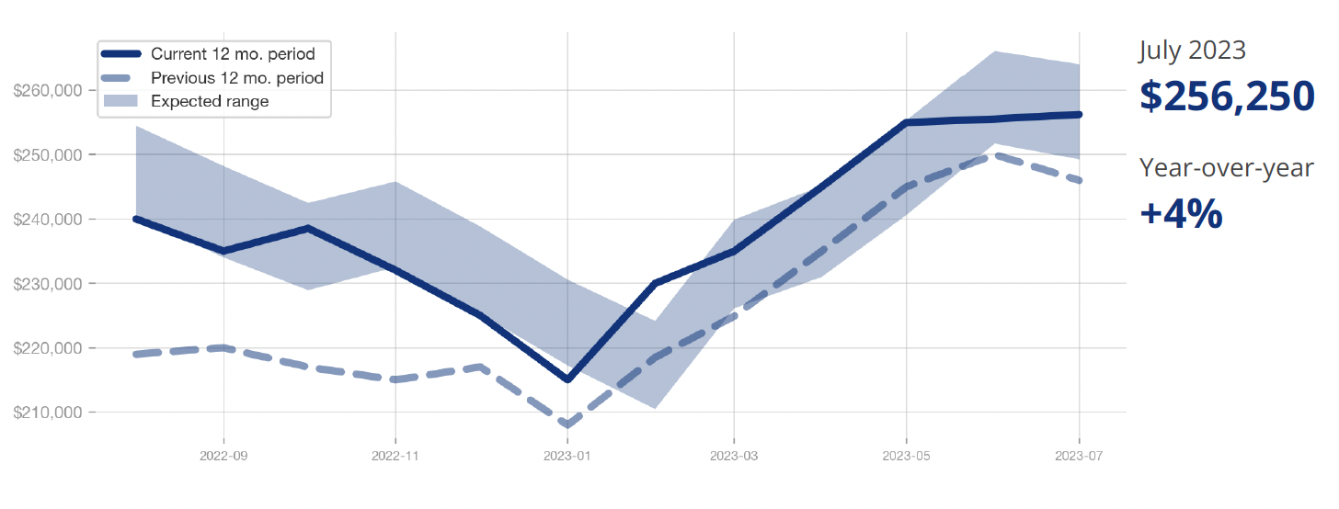
But tight inventory has kept prices at historic highs:

Slide 14
Indiana’s housing shortage is a long-term challenge

Slide 15
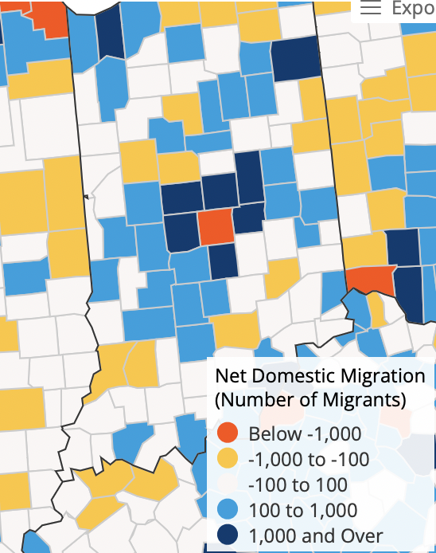
First the good news: Indiana population growth accelerates after 2017
Indiana’s overall population has grown by 300,000 since 2011 (162,000 households)
Lagged the nation but led the Midwest in population growth (2010-2022)
Net domestic migration positive from 2018-2022 (31,000+ new residents)
5,200+ net migration in 2022 (while Illinois, Ohio and Michigan lost a combined 158,000 residents)
Population, migration gains drive housing demand

Slide 16
Existing home sales steadily climbed from 2013-2021
Source: IAR MLS Data Warehouse

Slide 17
Residential inventory hasn’t kept up with demand

Slide 18
With supply trailing demand, Indiana has been a seller’s market since 2016
Buyer’s market
5.5 months of inventory
Balanced market
Seller’s market
1.4 months of inventory
Source: IAR MLS Data Warehouse

Slide 19
Hoosiers are staying in their homes longer, our housing stock is aging – and new construction isn’t filling the gap.
Ten-year permit total
per 1,000 households
Residential building permits
Source: Decennial Census, American Community Survey 1-Year Average, US Census Building Permit Survey

Slide 20
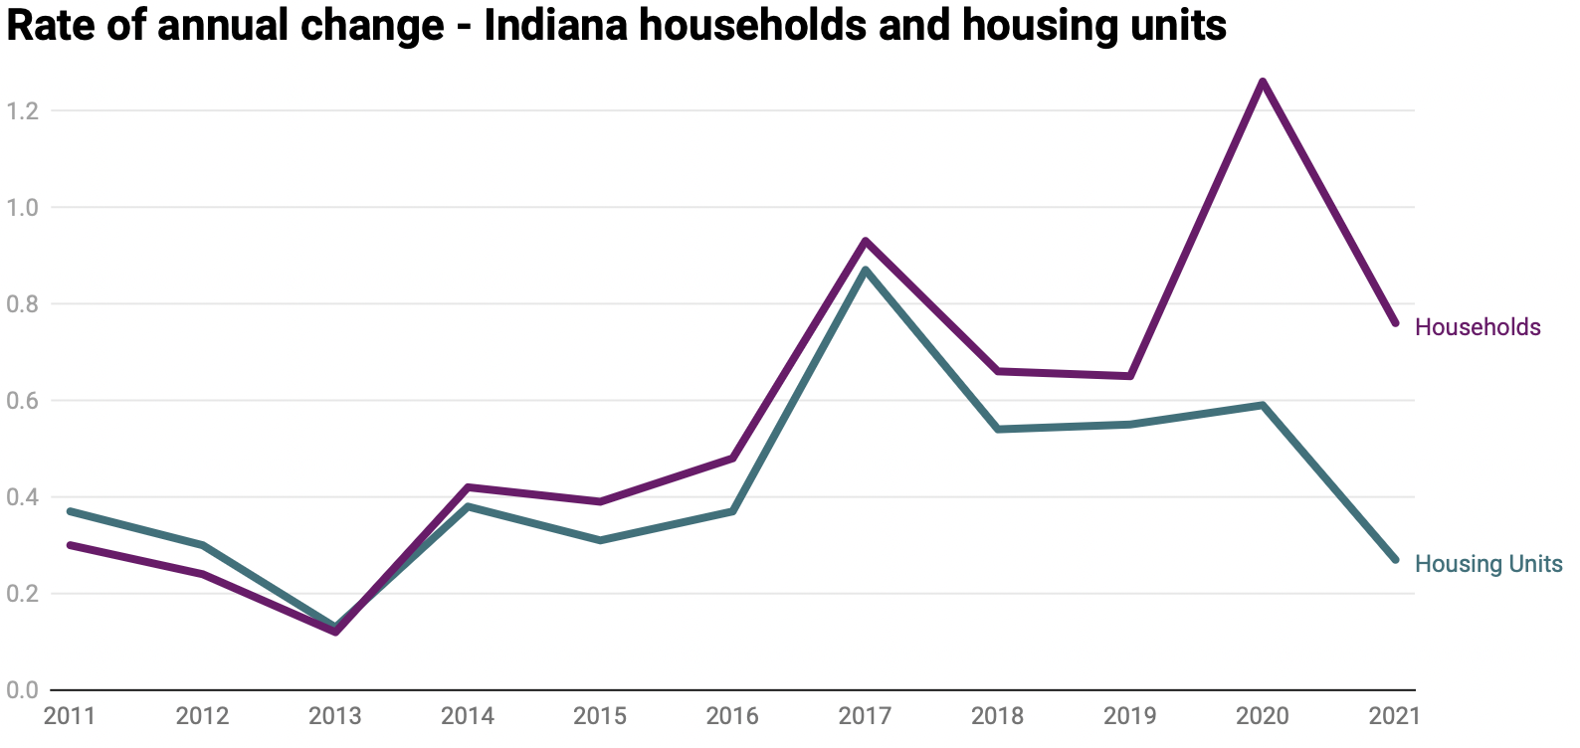
Indiana added 150,000 new households but >125,000 new (net) housing units, 2011-2021
45% of Indiana housing built pre-1970
(38% of U.S. housing units pre-1970)

Slide 21
Our housing shortage, positive migration & pandemic demand fueled 10% average annual price growth since 2018
Median sold price
Net domestic migration
Indiana Association or Realtors and Indiana Business Research Center

Slide 22
This pushed the median sale price from $157,000 in 2018 to $241,000 YTD
$500K+
$350-$499K
$250-$349K
$150-$249K
$0-$149K

Slide 23
Indiana homeowners are doing well, but it’s tougher than ever for first-time buyers to join them
Of the 1.2 million Indiana households with a mortgage, 235,000 are housing-cost burdened (19%) – better than the U.S.
45% of renter households are housing-cost burdened
The ‘median’ Indiana homeowner has gained roughly $75,000 in equity since the end of 2018
But with home prices growing faster than income and inventory tight, first-time buyers have a difficult path
= 10,000 households

Slide 24
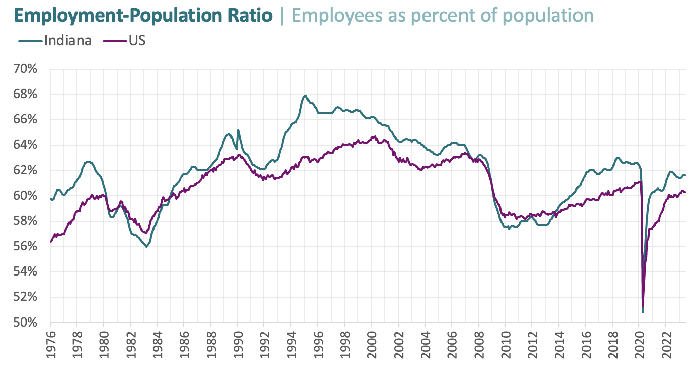
Hoosiers are back to work – but home prices have risen faster than wages
Indiana’s earnings have been in the middle of the pack among states
Buying power has diminished with 2021-2022 inflation – with home prices outgrowing CPI

Slide 25
Inventory affordable to moderate-income households has decreased sharply
A median Indiana household income ($62,000) can afford to buy a home just above $200,000 (current rates, 7% down)
The number of homes listed for sale under $200,000 has decreased 50% since 2018

Slide 26
Workforce housing demand also grows with economic investments and employment gains:
Indiana has gained two new private sector jobs for every new housing unit since 2011
Indiana’s median-priced home ($241,000) is affordable at a $68,000 income – above median wages
Housing availability is an increasingly important site selection priority, according to IEDC (40% of READI requests)
Lack of workforce housing pushes workers further from jobs

Slide 27
Indiana needs pro-growth housing policy

Slide 28
Final thoughts:
Inventory and affordability challenges aren’t going away
An undersupplied market drives up prices, limits sales potential and puts homeownership at risk
Housing development is economic development (“homes are where jobs sleep at night”)
HB1005 (housing infrastructure), READI 2.0 are major state-level wins
We also need increased federal support (Neighborhood Homes Investment Act) and a local commitment to pro-housing policies
A more balanced market means more business opportunities for REALTORS®

Slide 29
Thank you!

