Slide 1
Real Estate Market Outlook
Lawrence Yun, Ph.D.
Chief Economist
National Association of REALTORS®

Slide 2
Downgrade of USA Debt ???
Federal Outlay (blue bar) > Tax Receipts (orange line)

Slide 3
Federal Reserve Rate Hikes ... Next meeting in late September

Slide 4
GDP Growth Rate
% change annualized
Source: Department of Commerce

Slide 5
GDP Component on Residential Housing Investment
(Home building, Home sales, Mortgage Origination, Title, Appraisal, Remodeling, etc.)
% change annualized
Source: Department of Commerce

Slide 6
Inflation Steadily Calming Down ... 3% in June
With more deceleration underway as wage and rents moderate
Source: BLS

Slide 7
Price Growth by Key Items
Item | % change from a year ago
Car Insurance | 16.9%
Rent | 8.3%
Food | 5.8%
Electricity | 5.4%
Lodging Away from Home (Hotel/Airbnb) | 5.0%
New Car | 4.1%
Clothes | 3.1%
Medical Service | -1%
Airfare | -13%
Gasoline | -27%
Source: BLS

Slide 8
Rent of Primary Residence ... Start of Deceleration
Source: BLS

Slide 9
Annual Apartment Construction of 40 year high
... Why has Rent not calmed down?
Source: Census/HUD

Slide 10
Apartment Rent Growth in Private Sector Data
Source: CoStar

Slide 11
Weaker Home Sales ... Existing Home Sales below Pre-COVID .... Down 23% year-to-date
Seasonally adjusted annualized sale pace
Source: NAR

Slide 12
Newly Constructed Home Sales ... Back to Pre-COVID
Source: HUD

Slide 13
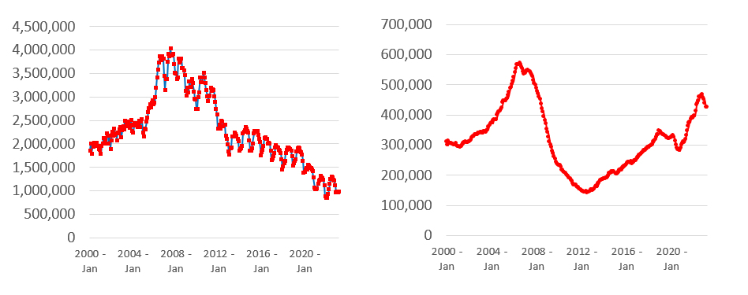
Inventory of Existing Homes Low ... New Homes High
Source: NAR and HUD

Slide 14
Home Price Appreciation in Michigan City – La Porte
% change from a year ago
Source: FHFA

Slide 15
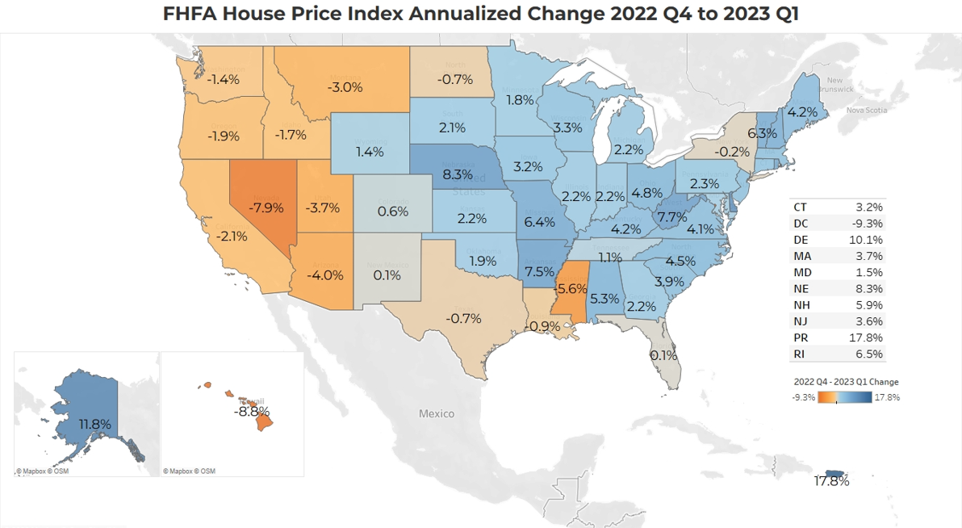
Home Price Change in 2023 Q1 from prior quarter
Source: NAR Analysis of FHFA data

Slide 16
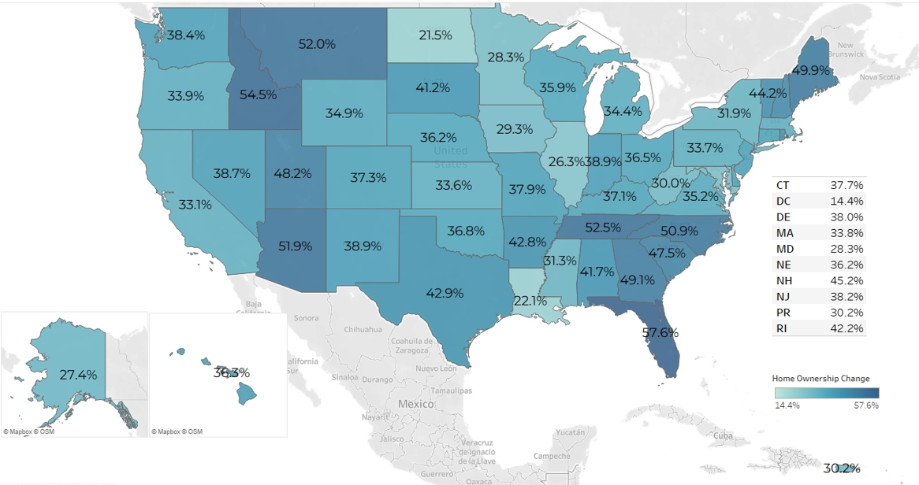
Home Price Change from onset of COVID (2020 Q1 to 2023)
Source: NAR Analysis of FHFA data

Slide 17
Serious Mortgage Delinquency (Late by 90 days or foreclosure)
Source: Mortgage Bankers Association

Slide 18
Job Market

Slide 19
Total Payroll Jobs ... 4 million more from pre-covid
Source: BLS

Slide 20
Job Openings > Those Searching for Job
Source: BLS

Slide 21
Out of Labor Force and Not Searching for Job
Source: BLS

Slide 22
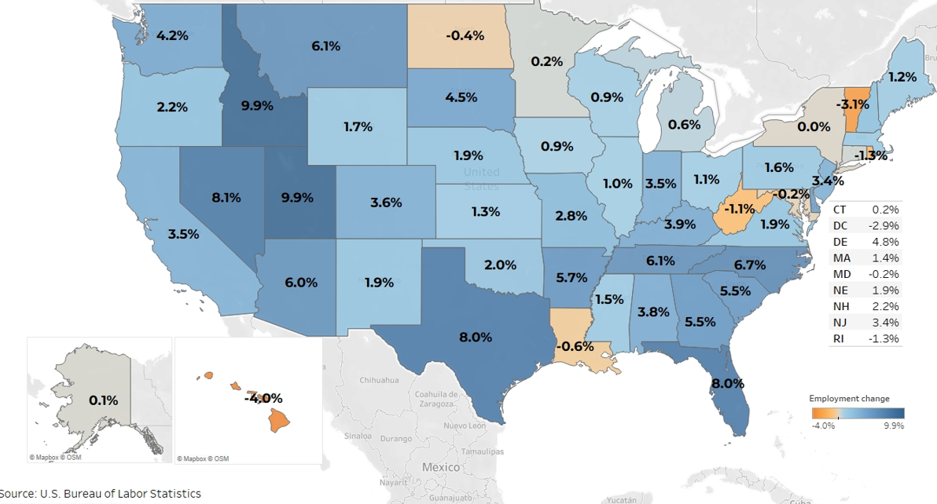
Job Gains Since Pre-Covid Record High Payroll Employment
(% change from March 2020 to June 2023)
7.6%
Source: NAR Analysis of BLS data

Slide 23
Jobs in Michigan City – La Porte
In thousands
Source: BLS

Slide 24
Jobs in Indianapolis
In thousands
Source: BLS

Slide 25
Mortgage Rate Forecast
Source: Freddie Mac and NAR forecast

Slide 26
Total Home Sales: New and Existing
Bottoming this year before upturn next year
Source: NAR forecast and HUD

Slide 27
Why Should Mortgage Rate Fall?
30-year Fixed Rate to be near 6% by the year end
Rents will calm down ... Holds down CPI ... and make the Fed stop raising interest rate
Community banks are suffering from high interest rates
Spread with government bond with return to normal

Slide 28
THANK YOU !

